Slide 1
Eshita Gangwar
18125760021

Slide 2

Customer Care Email Topic Extraction
Customer Care Email Topic Extraction

Slide 3
Problem Statement
Customer service centers are most crucial part of any company.
Emails are the most popular means of business communication.
In order to efficiently and effectively utilize time, the customer service centers need to extract the relevant information from these emails.
Then they need organizing it and promptly respond to the customers accordingly.

Slide 4
Business Understanding
The topic of emails is determined.
Text summarization is performed.

Slide 5
Data Understanding
The raw data is a 22.2 MB file.
No specific desired labels for the topics.
We would expect that if LDA works as intended, it would be able to separate out the topics with a similar structure to each discussion group

Slide 6
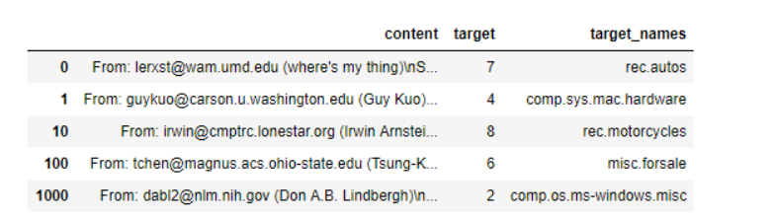
Dataset

Slide 7
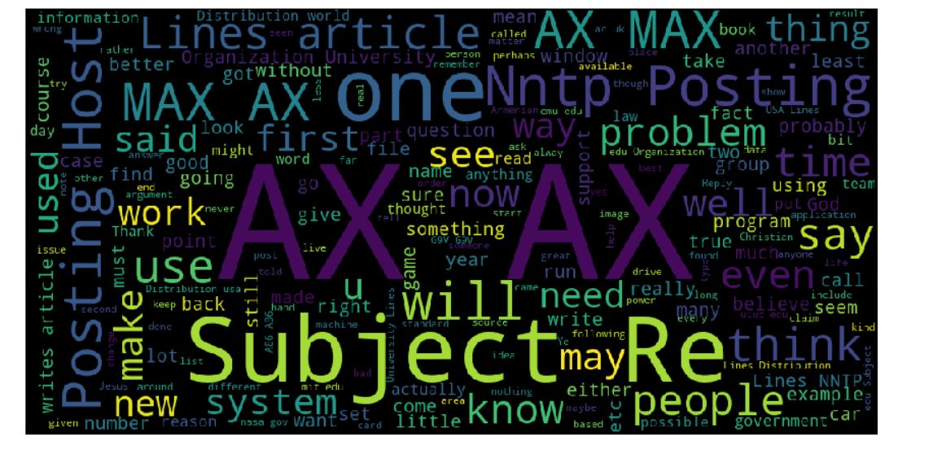
Word cloud of Data

Slide 8
Data Preparation
Tokenising words
Removing stopwords
Lemmatisation
Creating the dictionary and the corpus
Dictionary
Corpus

Slide 9
Tokens
Stop words
Lemmatization
Id2word

Slide 10
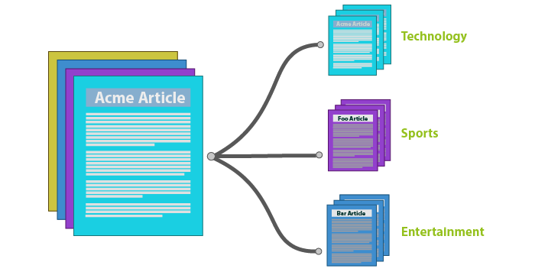
Approach
A Topic Model can be defined as an unsupervised technique to discover topics across various text documents. These topics are abstract in nature, i.e., words which are related to each other form a topic.

Slide 11
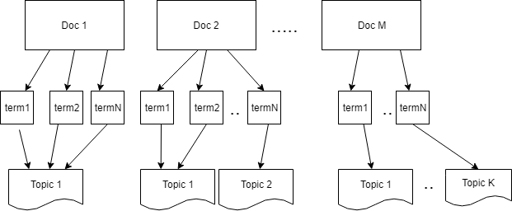
LDA
The documents made up of a distribution of topics, and the topics are represented by a distribution of words.
LDA algorithm assumes that combinations of topics and words, as well as the combinations of documents and topics.

Slide 12
Text Rank Algorithm
Split the text into individual sentences
vector representation for each and every sentence
Similarities between sentence vectors
The similarity matrix is then converted into a graph
A certain number of top-ranked sentences form the final summary

Slide 13
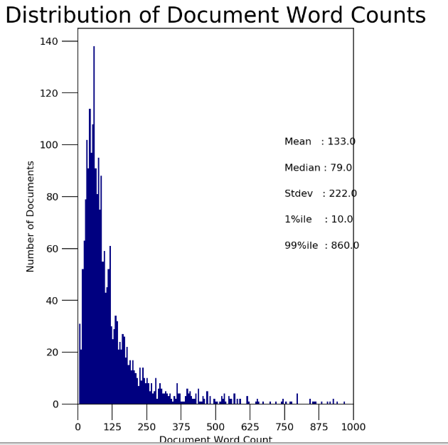
Data Visualisation

Slide 14
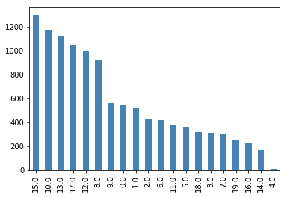
Number of Document per topic

Slide 15
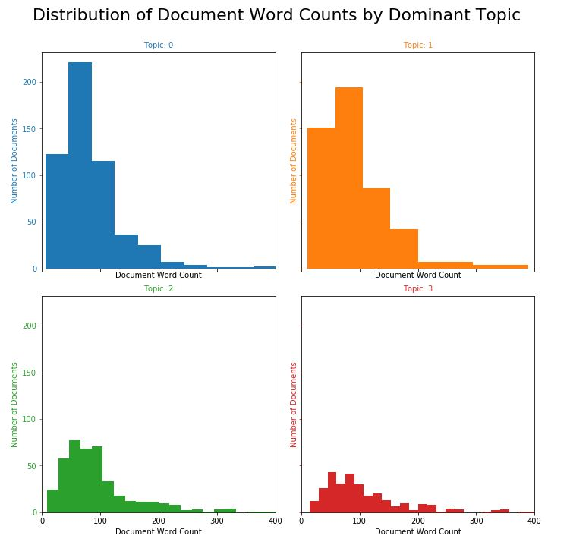
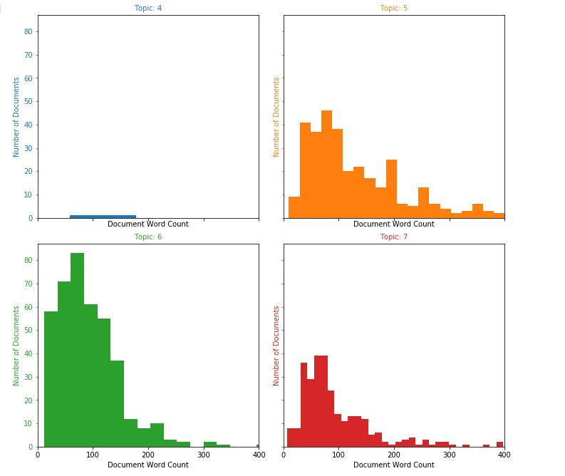

Slide 16
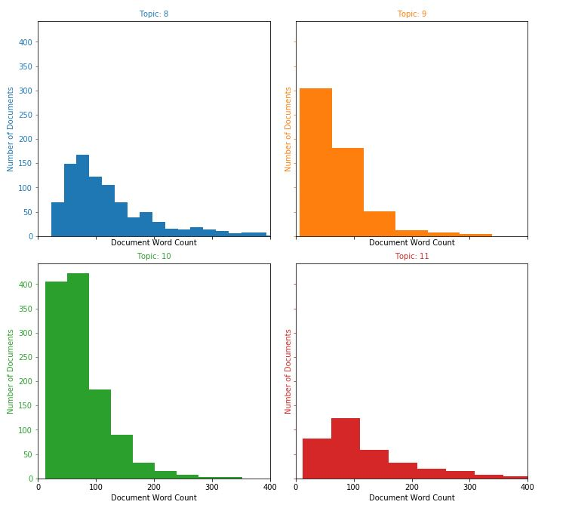
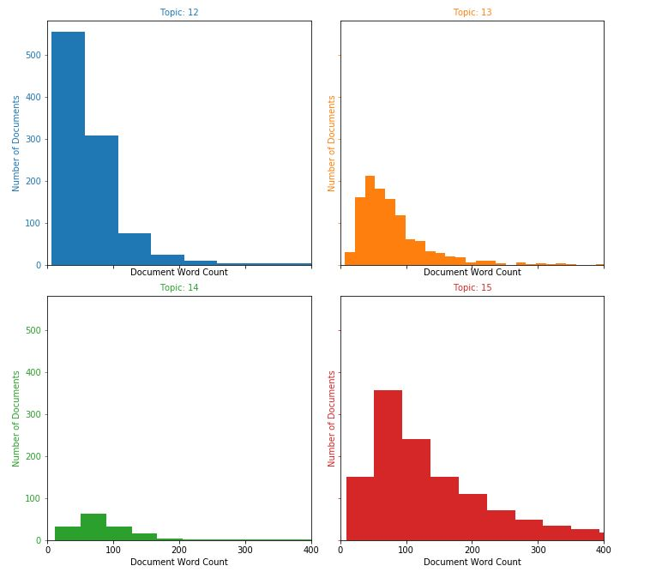

Slide 17
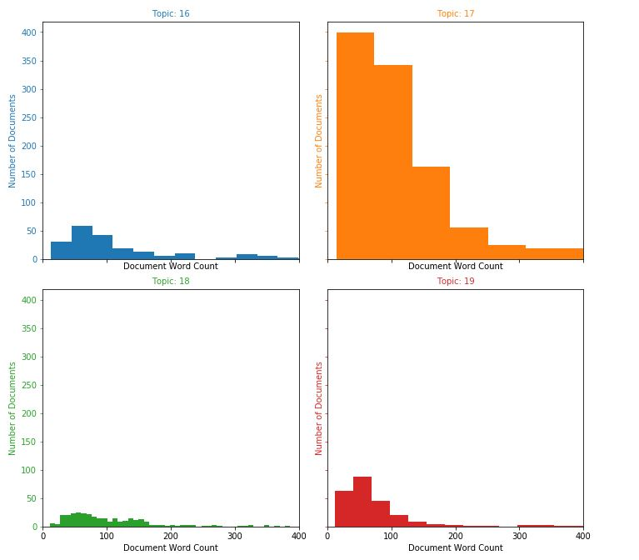

Slide 18
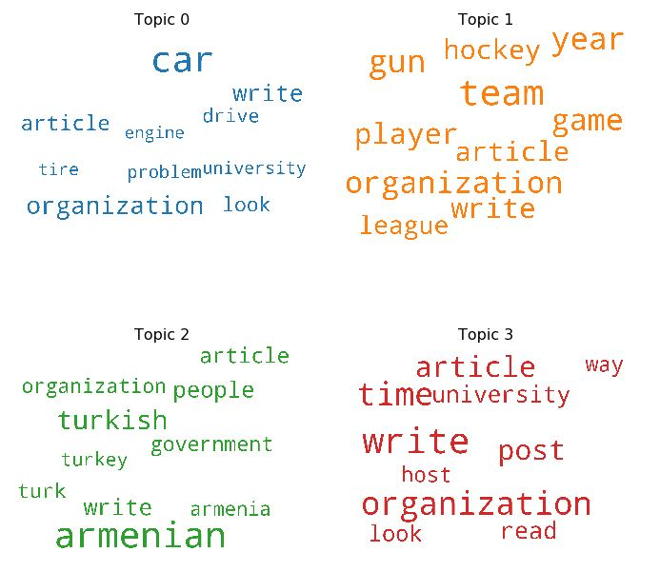
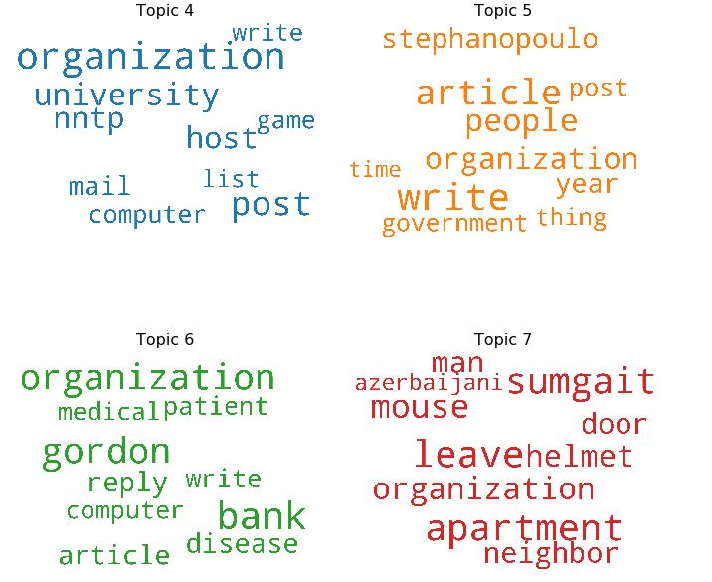
Word cloud for each Topic

Slide 19
Key Results
(9,
'0.011*"organization" + 0.009*"wire" + 0.007*"image" + 0.007*"write" + '
'0.006*"post" + 0.006*"scsi" + 0.005*"nntp" + 0.005*"wiring" + '
'0.005*"system" + 0.005*"host"'),
(10,
'0.020*"window" + 0.014*"drive" + 0.013*"organization" + 0.009*"problem" + '
'0.009*"disk" + 0.008*"post" + 0.008*"host" + 0.007*"write" + 0.007*"nntp" + '
'0.006*"university"'),
(11,
'0.010*"president" + 0.009*"state" + 0.007*"government" + 0.006*"mr" + '
'0.006*"law" + 0.006*"american" + 0.005*"people" + 0.004*"write" + '
'0.004*"policy" + 0.004*"organization"'),
(12,
'0.014*"organization" + 0.011*"post" + 0.009*"university" + 0.009*"host" + '
'0.009*"nntp" + 0.007*"mail" + 0.006*"game" + 0.006*"computer" + '
'0.006*"list" + 0.005*"write"')

Slide 20
Model Evaluation
Perplexity: Given a trained model, perplexity tries to measure how this model is surprised when it is given a new dataset. This is measured as the normalized log-likelihood of the held out test set. The lower the perplexity, the better the model
Coherence Score:The coherence of a topic by measuring the degree of semantic similarity between its high scoring words. These measurements help distinguish between topics that are human interpretable and those that are artifacts of statistical inference

Slide 21
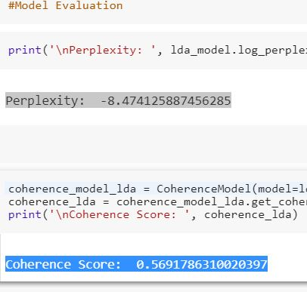

Slide 22
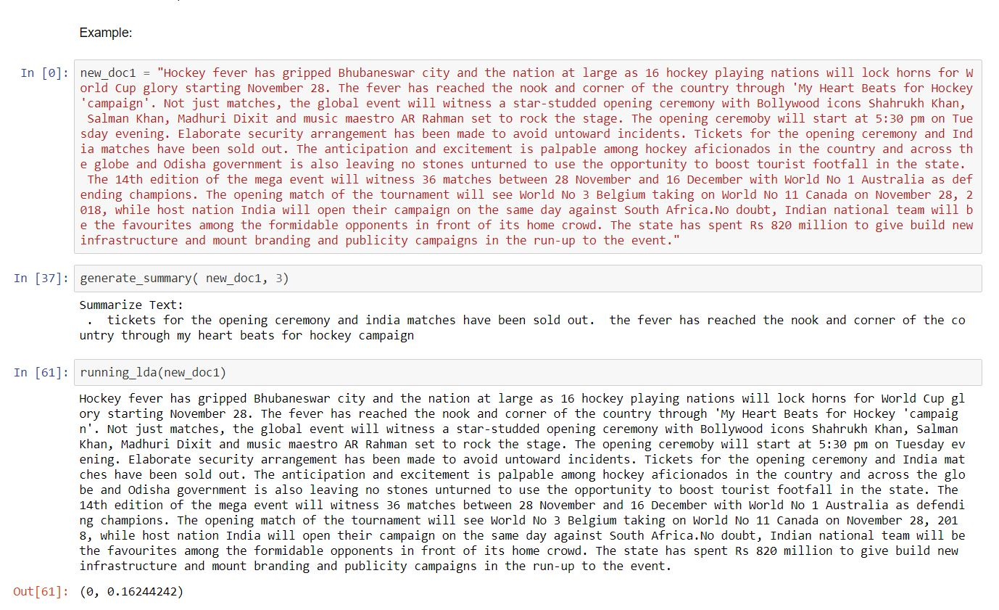
Working Module

Slide 23
Future Work
The work can be extended by adding some functionality for the user, such as an interface, so the complaints can be arranged according to the priority.
The emails at the customer service centers can be handled automatically reply. For this, templates can be created which will help to respond to distinctive types of emails appropriately.
Also, in future more data analysis can be performed on the data derived from customer service centers as they can serve as data sources to analyze customer needs and future trends.

